Slide 1
Fluid simulation
Jack van der Drift & Marjolein Zwerver

Slide 2
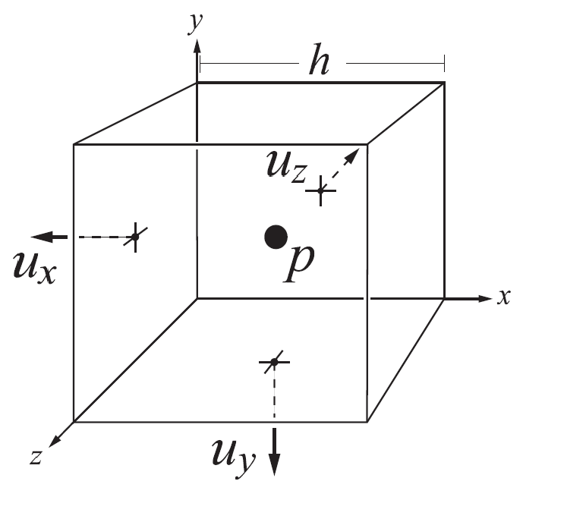
MAC grid
Fluid Flow for the rest of us – Cline, Cardon and Egbert
Divide the space into grid cells
For each cell
Store velocity components on corresponding faces
Store pressure at cell center
Use marker particles
Notes:
Marker and cell, markers are just position used to track water cells

Slide 3
Algorithm
Calculate time step ∆t
Update cell states
Advance the velocity field
Update fluid velocities
Apply external forces
Calculate pressure
Apply pressure
Update air velocities
Set solid cell velocities
Move marker particles

Slide 4
1. Calculate timestep ∆t
Loop over all velocity components to get max velocity
∆t = 1/v_{max}
Clamped between 0.01 and 0.1

Slide 5
2. Update cell states
Cell state matrix which keeps track of the state (water/air) for each cell
If a cell contains a marker particle it is marked as a water cell
Notes:
Loop over all particles

Slide 6
3a. Backwards particle trace
For each face:
Get interpolated velocity in x, y and z direction
Trace particle backwards:
pos_{prev} = pos_{old} - vel * ∆t
New velocity at face is the interpolated velocity at pos_{prev}
Notes:
Trace the particle backwards one timestep using that velocity and get a new previous position

Slide 7
3b. Apply external forces
Just gravity in our case
vel_{y} = vel_{y} - 9.81 * ∆t
Apply only to faces that border fluid
Notes:
Get new velocity by subtracting force of gravity for that timestep

Slide 8
3c. Calculate pressure
Only for fluid cells
A * P = B
Matrix A
Diagonal: -(number of non-solid neighbors)
Rest: 1 if neighbors, 0 otherwise
Adjusted divergence B: ρ/∆t * ∇u
Jacobi method to solve

Slide 9
3d. Apply pressure
Only applied to velocity components that border fluid cells
∇p(x, y, z) = p(x, y, z) - p(x - 1, y, z)
u_{x} = u_{x} - ∆t/ρ * ∇p(x, y, z)
Notes:
Calculate pressure gradient using backwards differences. New velocity equals old velocity

Slide 10
3e. Update air velocities
Only for a 1 cell buffer zone
Interpolated from bordering water cells
Notes:
Do not do faces bordering fluid cells, but faces one cell further away

Slide 11
Set solid cell velocities
Velocities that point into a wall are set to 0

Slide 12
Move marker particles
Velocity for each particle calculated by interpolating between face values
pos_{new} = pos_{old} + vel * ∆t

Slide 13
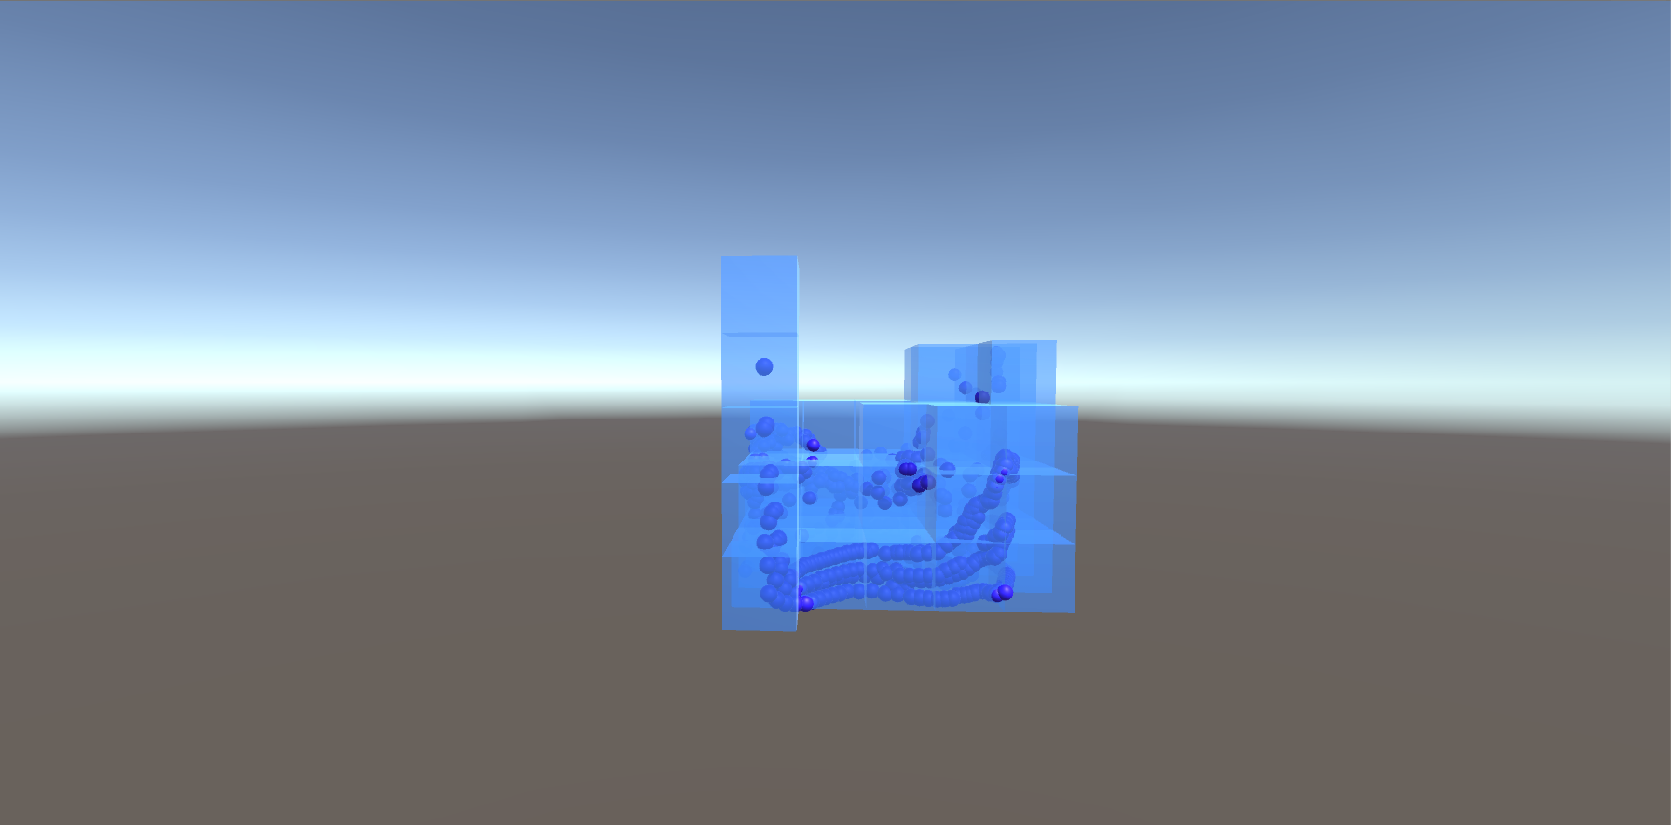
Demo

